Slide 1

深圳市金驹科技有限公司
Shenzhen Jinju Technology Co, Ltd.
承认书
Acknowledgment
客户名称（ client‘s name ）：
客户料号（ Customer item number ）：
产品型号（ Product number ）：
JJ-512436
产品名称（ product name ）：
DC-DC 降压恒流驱动电源
编制日期（ Date of preparation ）：
制定
（Formulate）
审核
（Review）
批准
（Approve）
承认
（Admit）
审核
（Review）
批准
（Approve）
厂商：深圳市金驹科技有限公司
地址：深圳市龙城街道龙西社区清水路鹏大地工业区14栋4楼
电话：0755 – 84861299 传真：0755 - 84860299
邮箱:2880362299@qq.com 网址：http://www.szjjpower.cn/ http://www.szjjled.com/
Manufacturer: Shenzhen Jinju Technology Co., Ltd.
Address: 4th Floor, Building 14, Peng Dadi Industrial Zone, Qingshui Road, Longxi Community, Longcheng District, Shenzhen
Tel: 0755 – 84861299 Fax: 0755 – 84860299 E-mail: 2880362299@qq.com
Website: http://www.szjjpower.cn/ http://www.szjjled.com/

Slide 2
产品描述
Product description
本电源是一款LED隔离设计的高品质，高稳定性的LED防水恒流驱动电源。内部滤波器件采用绿宝石，核心元器件都是IR进口，以保证产品的质量和可靠性。具有启动快速，兼容负载范围宽，保护功能齐全，采用国际知名大厂成熟方案，DC24V输入，DC18-20V输出，高精确的恒流控制，极高的效率和可靠的性能，以及小型的外观结构会使你的灯具更加趋于完美。
✶ This power supply is a high quality and stable LED Waterproof constant current driving power supply with LED isolation design. Emerald is used as the internal filter and IR is imported as the core components to ensure the quality and reliability of the products. With fast start-up, wide compatible load range and complete protection functions, it adopts the mature scheme of international famous large factories, DC24V input, DC18-20V output, high precise constant current control, high efficiency and reliable performance, and small appearance structure, which will make your lamps more perfect.
产品特点
Product characteristics
输入DC24V，加防反接保护功能 。
输出DC18-20V,恒流1.8A。
输出开路、短路、过压、过温保护。
支持串联写码，安装时，无需单个电源写码，大大提高安装效率。
装配尺寸小，可适用于各种需安全供电的场合使用。
采用LED专用防水环氧树脂AB胶，通过导热胶与铝壳接触，散热效果极佳，室内户外均可使用，两端各设两个机械固定孔位，适用于多种内部安装应用。
✶ Input DC24V, with anti reverse protection function.
✶ Output DC18-20V, constant current 1.8A.
✶ Output open circuit, short circuit, over-voltage, over temperature protection.
✶ Support serial code writing, no need for single power supply code writing during installation, greatly improving installation efficiency.
✶ Small assembly size, can be used in all kinds of occasions requiring safe power supply.
✶ It adopts LED special waterproof epoxy resin AB glue, which contacts with aluminum shell through heat conduction glue, with excellent heat dissipation effect. It can be used indoors and outdoors. Two mechanical fixing holes are set at both ends, suitable for various internal installation applications.

Slide 3
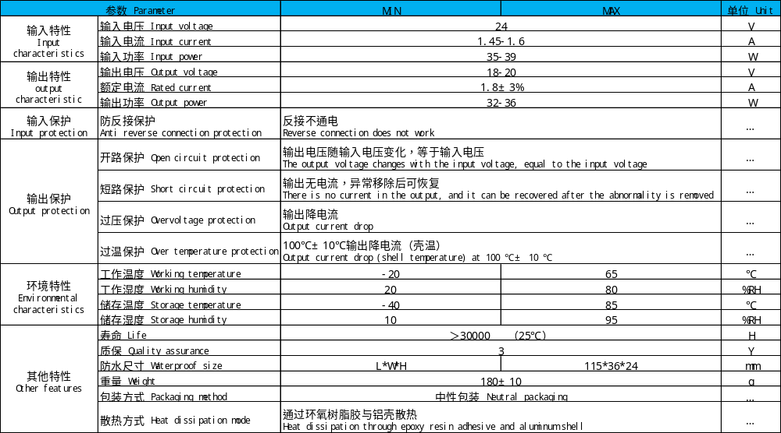
电气规格 Electrical specifications

Slide 4
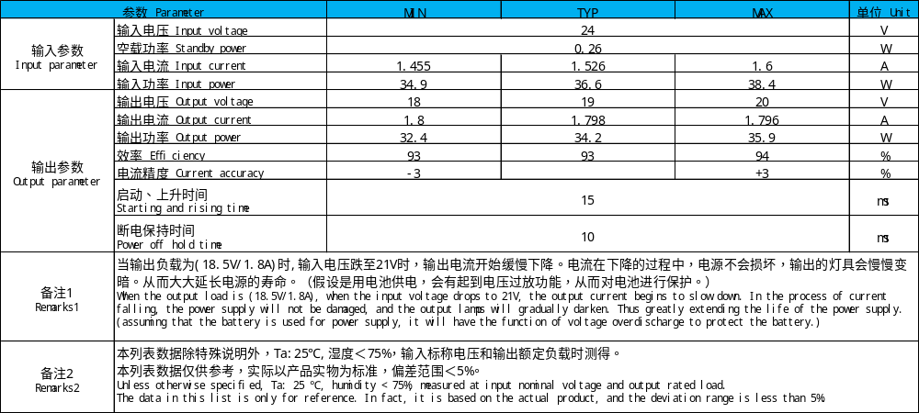
电性参数 Electrical parameters

Slide 5
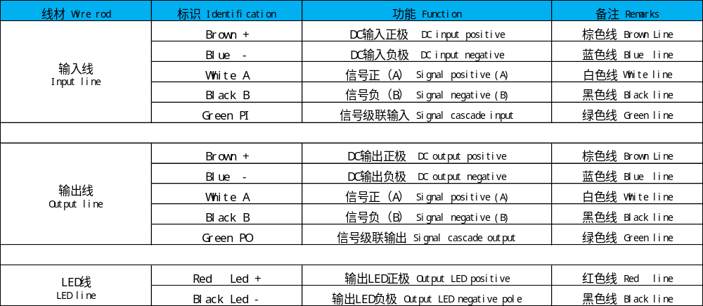
电源接线方式 Power wiring mode

Slide 6
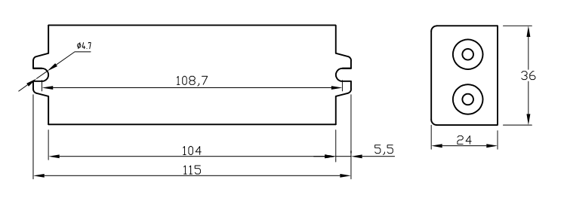
安装尺寸图 Installation dimension drawing
Unit：mm

Slide 7
产品使用说明
Product instructions
本产品主要应用于LED灯具（照明灯，景观灯, 水底投光灯、太阳能路灯等），整机功率为36W。
本产品是长形设计，操作时避免产品变形。产品两段各有两条电缆线，电源输入端是直流电输入，对应标贴纸上DC“+”和DC“-”，
另一端标贴纸上标有“LED+”、“LED-”，
“LED+”为输出正端，接LED正极，
“LED-”为输出负端，接LED负极。
使用时请注意安全，防止触电，避免与金属短路，必须用绝缘材料套好后方能放入灯具内。
注：在使用本电源时，请注意区分输入端和输出端，确保正确接线，核对无误后才能通电。
注：请确保输入线正负极不接反，确认无误，再开电源。
注：请先接好DC输出端的负载，确认无误，再开电源。
✶ The product is mainly used in LED lamps (lighting, landscape lights, underwater projection lights, solar street lights, etc.), with a total power of 36W.
✶ This product is designed to be long and avoid deformation during operation. There are two cables in each section of the product. The power input end is DC input, corresponding to DC "V +" and DC "V -" on the label,"Led +" and "led -" are marked on the other end of the sticker,"Led +" is the output positive terminal, connected to the LED positive terminal,"Led -" is the output negative terminal, connected to the LED negative terminal.Please pay attention to safety when using, prevent electric shock, avoid short circuit with metal, and put it into the lamp only after being covered with insulating material.
Note: when using this power supply, please pay attention to distinguish the input terminal and output terminal, ensure the correct wiring, and power on after checking.Note: please make sure that the positive and negative poles of the input line are not connected reversely, and then turn on the power supply.Note: please connect the load of DC output terminal, confirm it is correct, and then turn on the power supply.

Slide 8
常见故障及处理方法 Common faults and Solutions
灯具不亮☞
Lamps and lanterns are not bright
请切断DC输入端并检查：
Please cut off the DC input and check:
1.DC输出端是否接触不良；
Whether the DC output terminal is in poor contact;
2.DC输出端正负极是否接反；
Whether the positive and negative poles of DC output end are connected reversely;
3.DC输入端是否接触不良；
Whether the DC input is in poor contact;
4.DC输入供电电源，功率是否够大，能否正常带的起36W负载。
Whether the power of DC input power supply is large enough and whether it can normally carry 36W load.
排除以上故障后再测试。
Remove the above faults before testing.
灯具抖闪☞ Lighting flicker
请切断DC输入端，检查DC输出端：
Please cut off the DC input and check the DC output:
1.有无过载、超载；
Whether there is overload or overload;
2.电源设计参数与实际使用参数不符。
The power supply design parameters are inconsistent with the actual use parameters.
注：产品在使用过程当中如遇到其它疑问和问题，请及时与我司沟通、反馈不良信息，我司将积极助贵公司解决好问题。
Note: in case of any other questions and problems during the use of the product, please communicate with our company in time and feed back the bad information. Our company will actively help your company to solve the problems.

